Slide 1

Collection
CCS0023/L
Object Oriented Programming (Java)

Slide 2
09
LESSON #09
Collection
Collection

Slide 3
Collection
The Collection in Java is a framework that provides an architecture to store and manipulate the group of objects.
Java Collections can achieve all the operations that you perform on a data such as searching, sorting, insertion, manipulation, and deletion.
Java Collection means a single unit of objects. Java Collection framework provides many interfaces (Set, List, Queue, Deque) and classes (ArrayList, Vector, LinkedList, PriorityQueue, HashSet, LinkedHashSet, TreeSet).
Exception

Slide 4
Collection
The Collection in Java is a framework that provides an architecture to store and manipulate the group of objects.
What is Collection in Java
A Collection represents a single unit of objects, i.e., a group.
What is a framework in Java
It provides readymade architecture.
It represents a set of classes and interfaces.
It is optional.
What is Collection framework
The Collection framework represents a unified architecture for storing and manipulating a group of objects. It has:
Interfaces and its implementations, i.e., classes
Algorithm
Exception

Slide 5
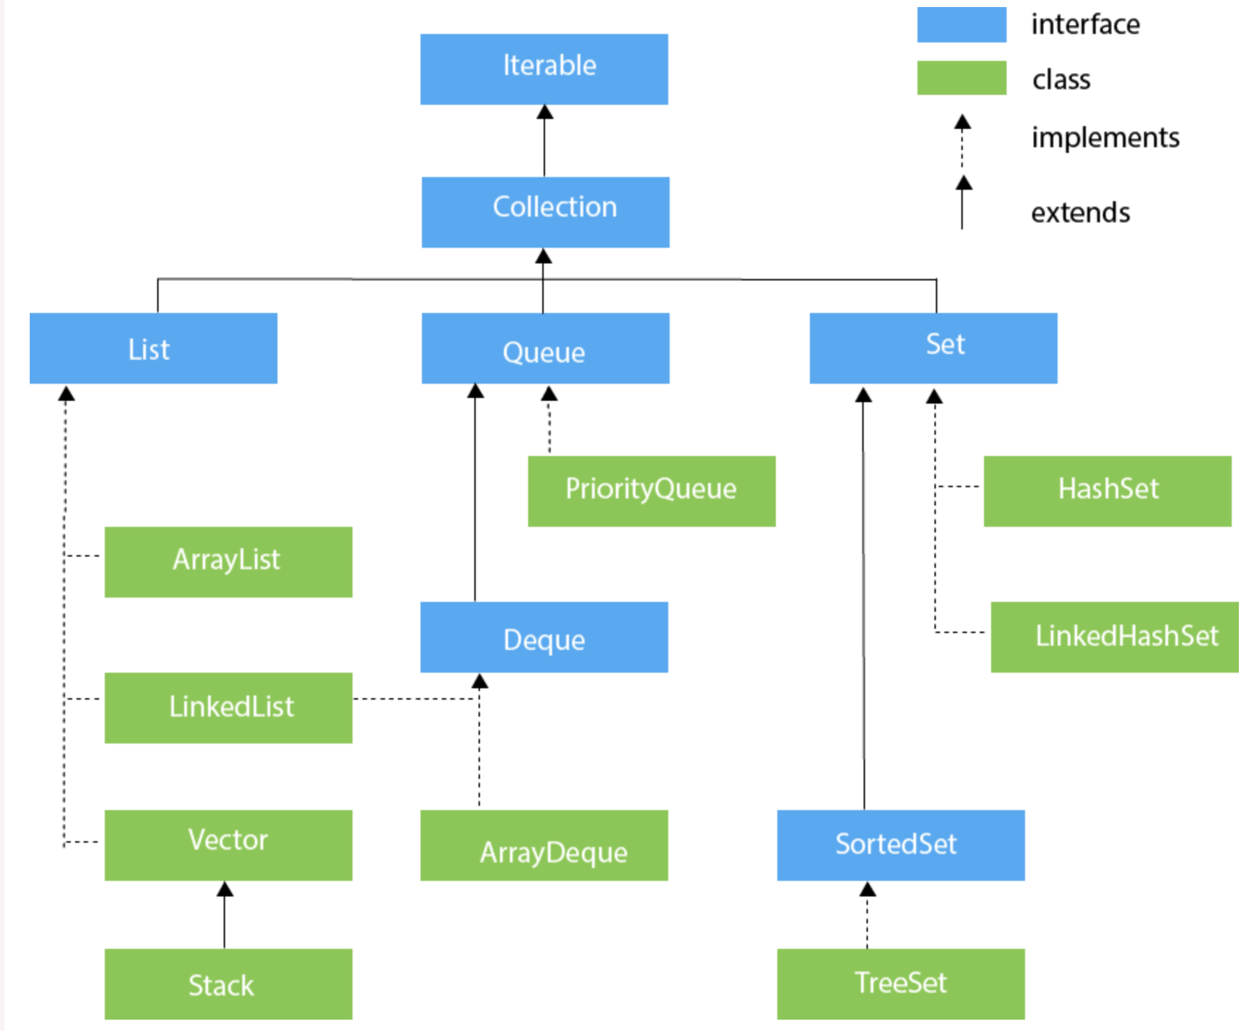
Hierarchy of Collection Framework
The java.util package contains all the classes and interfaces for the Collection framework.
Exception

Slide 6
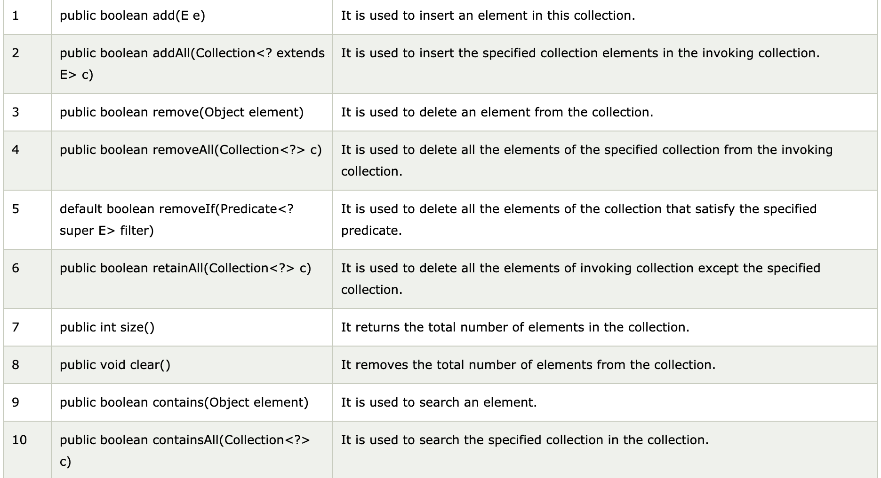
Methods of Collection interface
Collection

Slide 7
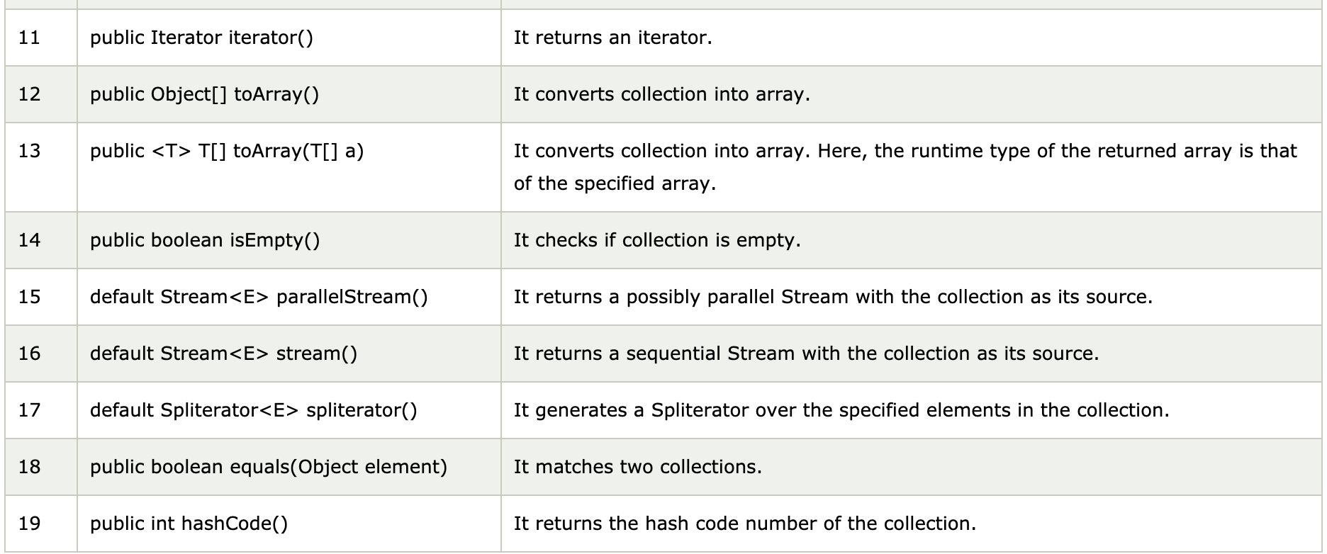
Methods of Collection interface
Collection

Slide 8
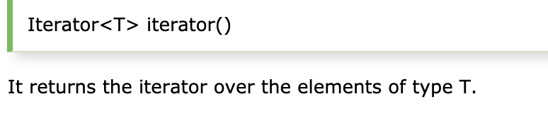
Iterable Interface
The Iterable interface is the root interface for all the collection classes. The Collection interface extends the Iterable interface and therefore all the subclasses of Collection interface also implement the Iterable interface.
It contains only one abstract method. i.e.,
Exception

Slide 9
Collection Interface
The Collection interface is the interface which is implemented by all the classes in the collection framework. It declares the methods that every collection will have. In other words, we can say that the Collection interface builds the foundation on which the collection framework depends.
Some of the methods of Collection interface are Boolean add ( Object obj), Boolean addAll ( Collection c), void clear(), etc. which are implemented by all the subclasses of Collection interface.
Collection

Slide 10
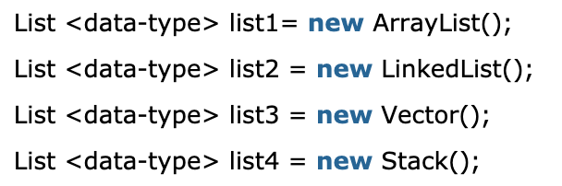
List Interface
List interface is the child interface of Collection interface. It inhibits a list type data structure in which we can store the ordered collection of objects. It can have duplicate values.
List interface is implemented by the classes ArrayList, LinkedList, Vector, and Stack.
To instantiate the List interface, we must use :
There are various methods in List interface that can be used to insert, delete, and access the elements from the list.
Collection

Slide 11
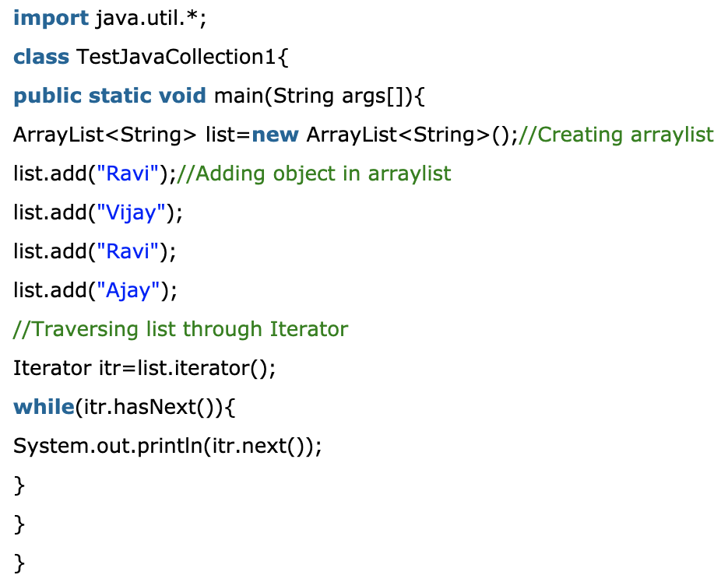
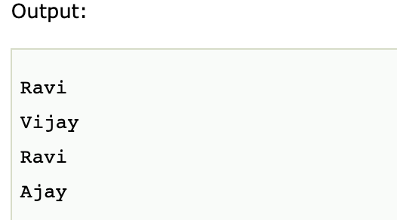
ArrayList
The ArrayList class implements the List interface. It uses a dynamic array to store the duplicate element of different data types. The ArrayList class maintains the insertion order and is non-synchronized. The elements stored in the ArrayList class can be randomly accessed.
Collection

Slide 12
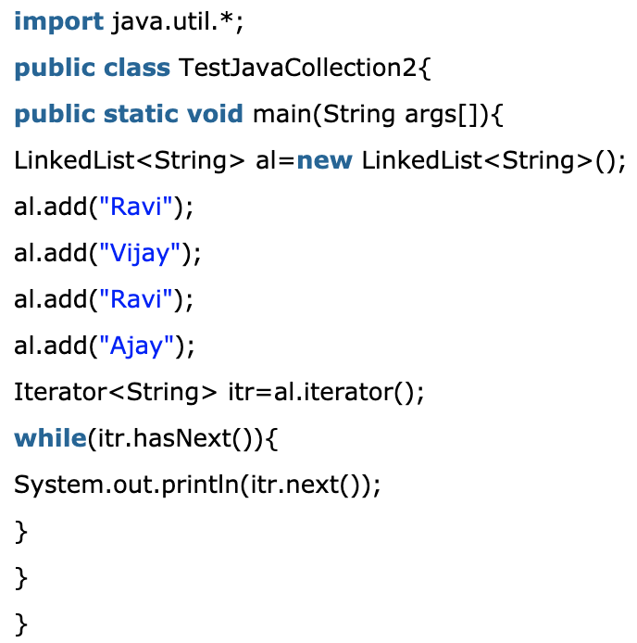
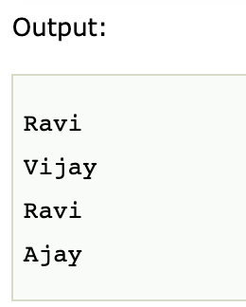
LinkedList
LinkedList implements the Collection interface. It uses a doubly linked list internally to store the elements. It can store the duplicate elements. It maintains the insertion order and is not synchronized. In LinkedList, the manipulation is fast because no shifting is required.
Collection

Slide 13
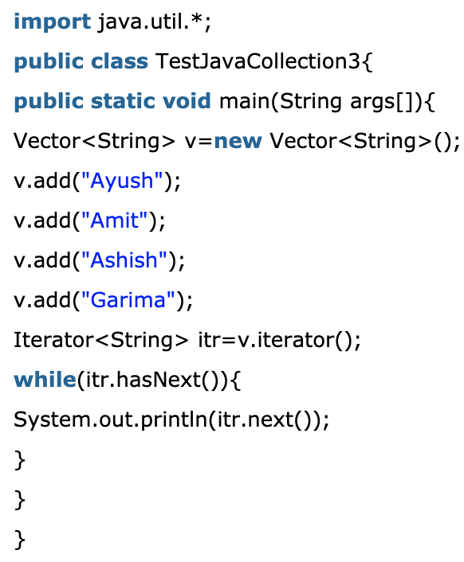
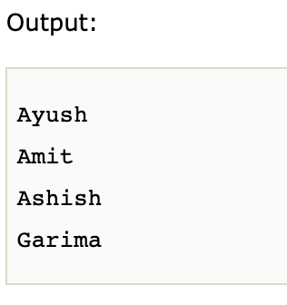
Vector
Vector uses a dynamic array to store the data elements. It is similar to ArrayList. However, It is synchronized and contains many methods that are not the part of Collection framework.
Collection

Slide 14
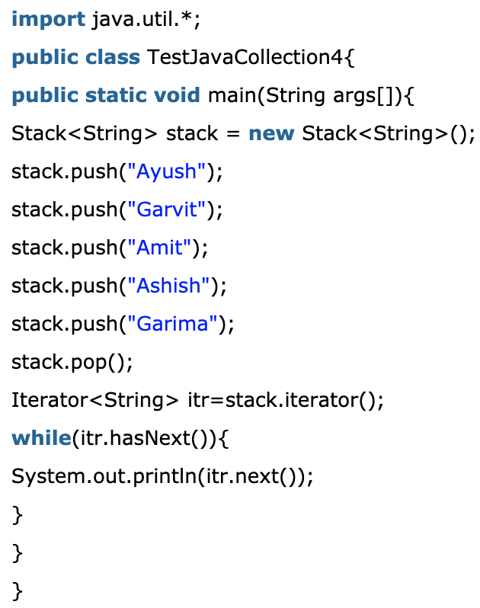
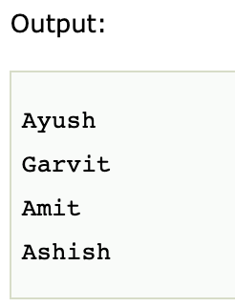
Stack
The stack is the subclass of Vector. It implements the last-in-first-out data structure, i.e., Stack. The stack contains all of the methods of Vector class and also provides its methods like boolean push(), boolean peek(), boolean push(object o), which defines its properties.
Collection

Slide 15
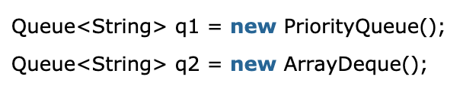
Queue Interface
Queue interface maintains the first-in-first-out order. It can be defined as an ordered list that is used to hold the elements which are about to be processed. There are various classes like PriorityQueue, Deque, and ArrayDeque which implements the Queue interface.
Queue interface can be instantiated as:
Collection

Slide 16
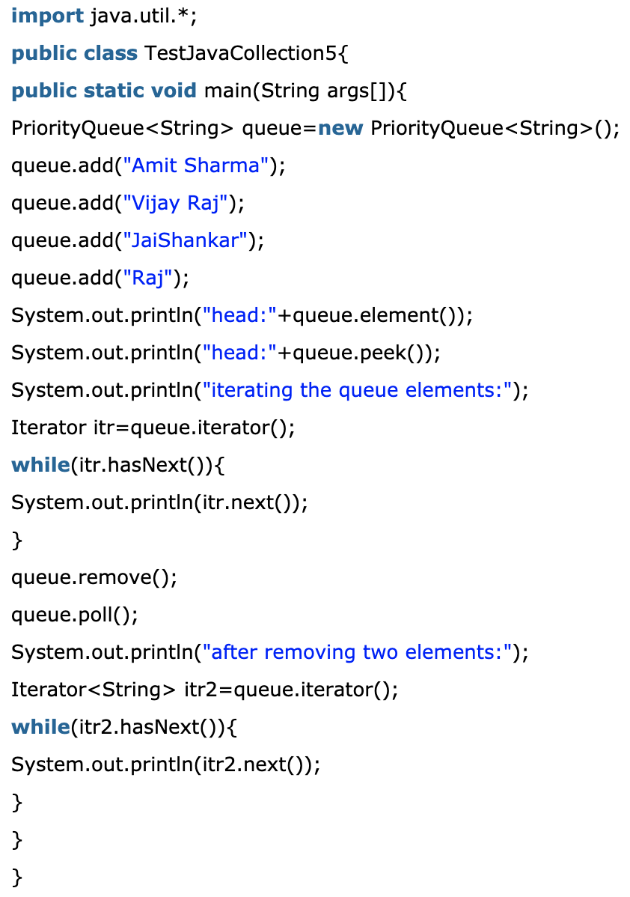
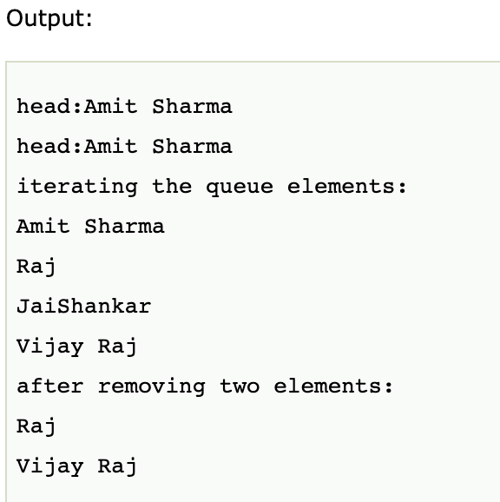
PriorityQueue
The PriorityQueue class implements the Queue interface. It holds the elements or objects which are to be processed by their priorities. PriorityQueue doesn't allow null values to be stored in the queue.
Collection

Slide 17
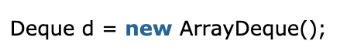
Deque Interface
Deque interface extends the Queue interface. In Deque, we can remove and add the elements from both the side. Deque stands for a double-ended queue which enables us to perform the operations at both the ends.
Deque can be instantiated as:
Collection

Slide 18
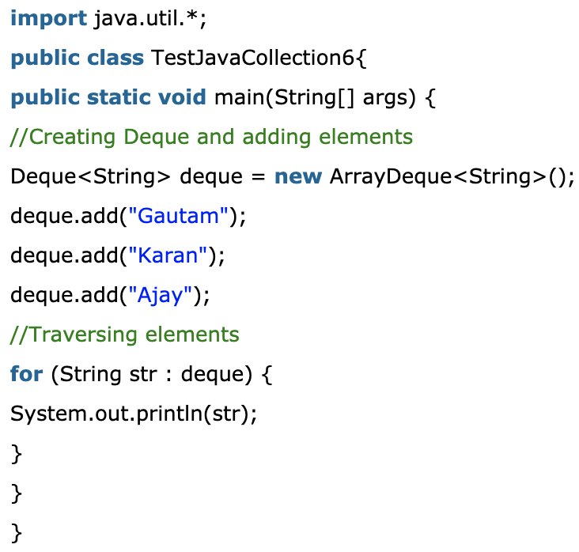
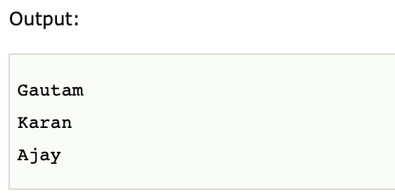
ArrayDeque
ArrayDeque class implements the Deque interface. It facilitates us to use the Deque. Unlike queue, we can add or delete the elements from both the ends.
ArrayDeque is faster than ArrayList and Stack and has no capacity restrictions.
Collection

Slide 19
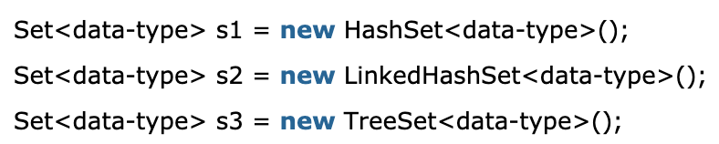
Set Interface
Set Interface in Java is present in java.util package. It extends the Collection interface. It represents the unordered set of elements which doesn't allow us to store the duplicate items. We can store at most one null value in Set. Set is implemented by HashSet, LinkedHashSet, and TreeSet.
Set can be instantiated as:
Collection

Slide 20
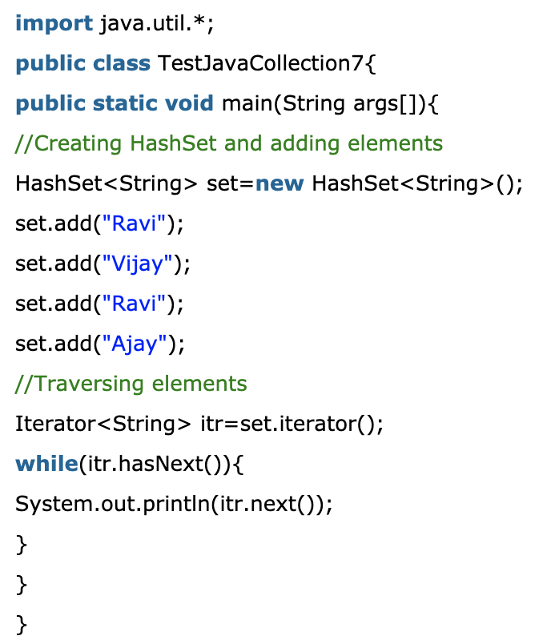
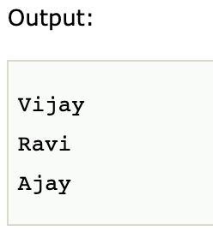
Hashset
HashSet class implements Set Interface. It represents the collection that uses a hash table for storage. Hashing is used to store the elements in the HashSet. It contains unique items.
Collection

Slide 21
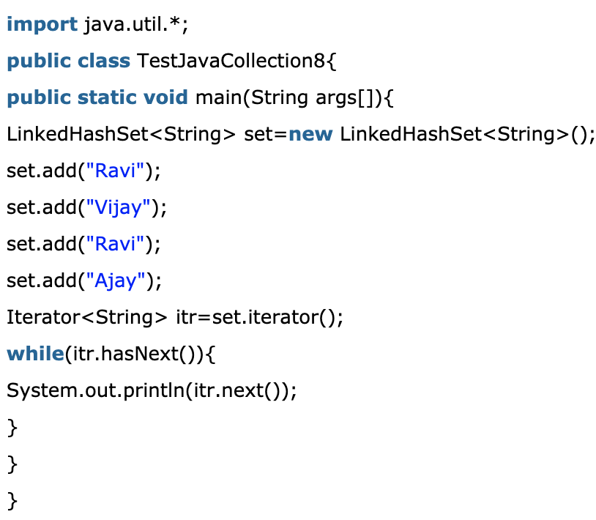
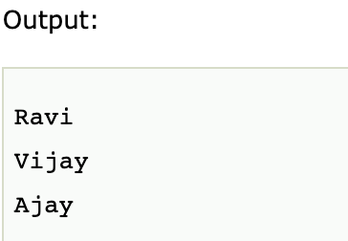
Linked Hashset
LinkedHashSet class represents the LinkedList implementation of Set Interface. It extends the HashSet class and implements Set interface. Like HashSet, It also contains unique elements. It maintains the insertion order and permits null elements.
Collection

Slide 22
SortedSet Interface
SortedSet is the alternate of Set interface that provides a total ordering on its elements. The elements of the SortedSet are arranged in the increasing (ascending) order. The SortedSet provides the additional methods that inhibit the natural ordering of the elements.
The SortedSet can be instantiated as:
Collection

Slide 23
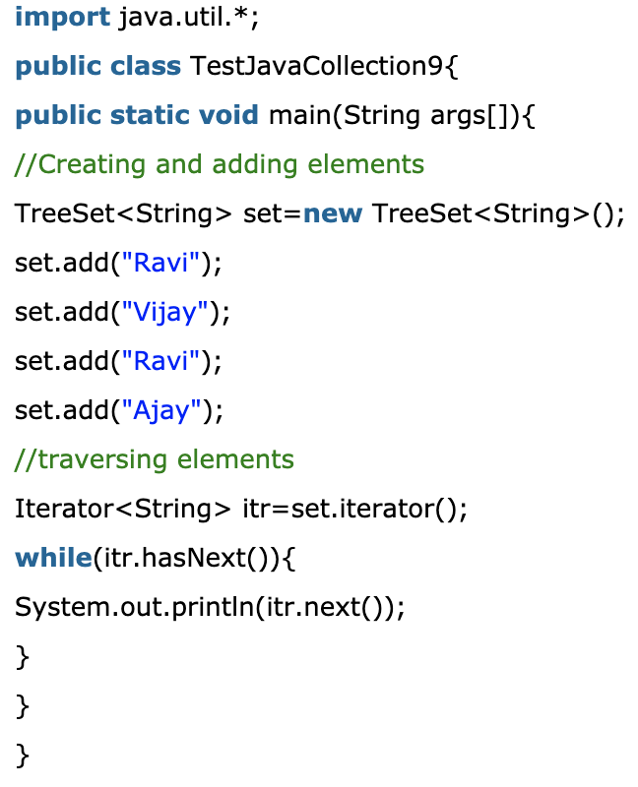
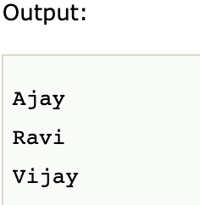
TreeSet
Java TreeSet class implements the Set interface that uses a tree for storage. Like HashSet, TreeSet also contains unique elements. However, the access and retrieval time of TreeSet is quite fast. The elements in TreeSet stored in ascending order.
Collection

